Slide 1
Process of extracting boreholes from tables
With code from borehole/extraction.py
Anna Andraszek

Slide 2
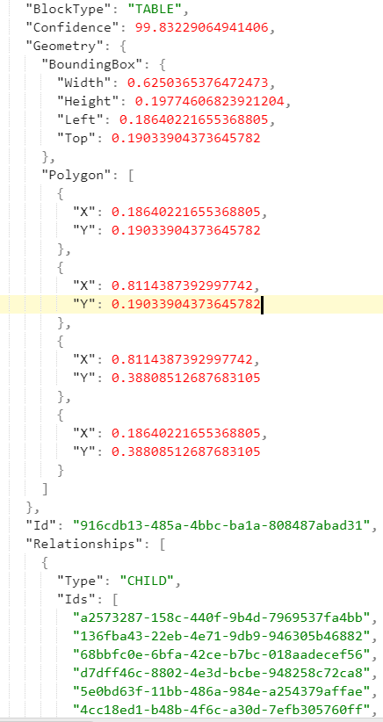
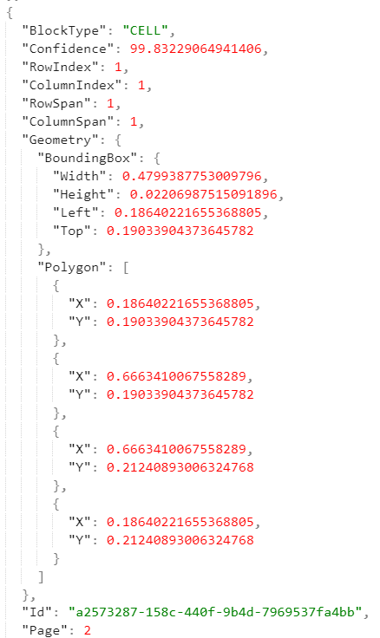
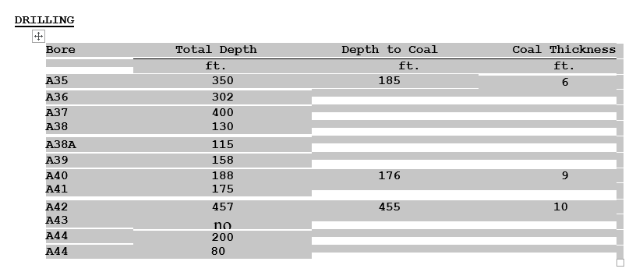
1. Get files which contain tables
If extracting data from reports with Textract, this will be the json response, which also contains table information if the Tables feature has been used.
If using a service which converts PDFs to Word, this will be the converted Word file.

Slide 3
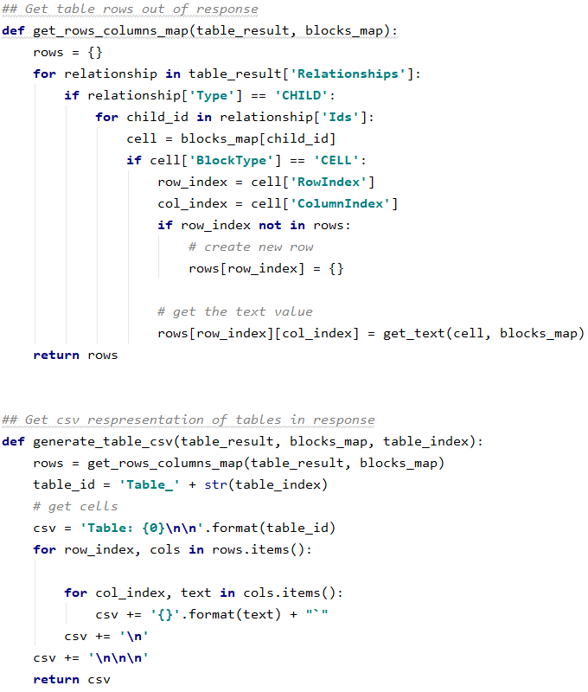
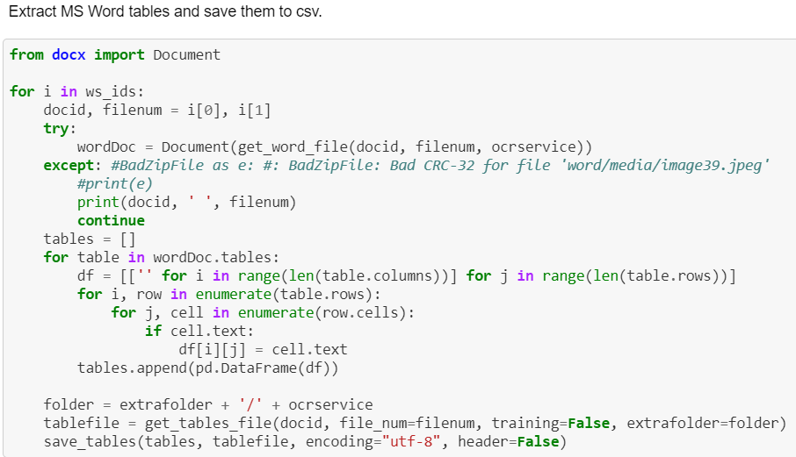
2. Extract tables from source file
For Textract, get contents of CELL blocks and save to csv. (all tables in one file saved to one file) (see texttransforming.py, or code on right).
For a Word file, use python-docx (see ‘Comparing table extraction between different services.ipynb’, or code below).

Slide 4
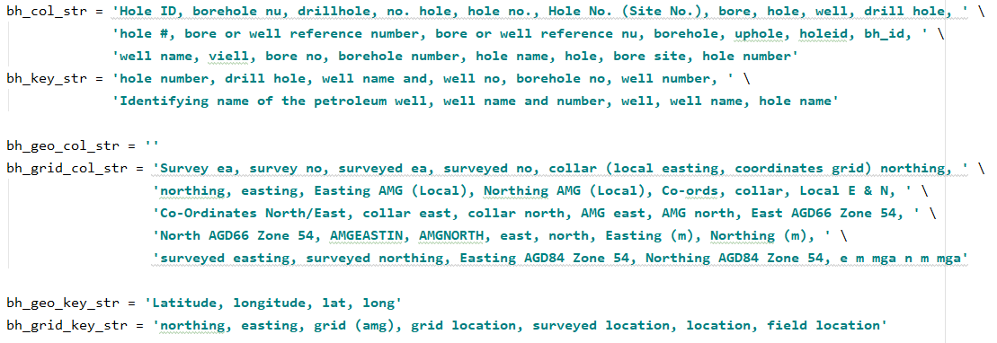
3. Create lists of search terms
Create lists of column and key terms you will be searching for. These categories are currently:
- Borehole, grid location, geographical location
Differentiating between column and key names

Slide 5
4. Searching tables
## Extract boreholes for a certain report def extract_bh(docid, filenum=None, bh=False, training=True, extrafolder='', fname=bhcsv_all): sep = '`' if 'wondershare' in extrafolder: sep = ',' if not filenum: fs = [] if '_' not in docid: if not training: files = glob.glob('C:\\Users\\andraszeka\\OneDrive - ITP (Queensland Government)\\textract_result\\' + extrafolder + '/tables/cr_' + docid + '*.csv') else: files = glob.glob(paths.training_file_folder + '/tables/cr_' + docid + '*.csv') for file in files: f = file.split('\\')[-1].replace('_tables.csv', '').replace('cr_' + docid + '_', '') fs.append(f) else: docid, file = docid.split('_') fs = [file] else: fs = [filenum]
for file in fs: try: bhtables = get_tables(docid, bh=bh, report_num=file, training=training, extrafolder=extrafolder, sep=sep) except FileNotFoundError: print('No file for ', str(docid), '_', file, ' bh: ', str(bh)) return bh_data = pd.DataFrame(columns=bh_data_cols) for table in bhtables: res1 = extract_from_columns(table) res2 = extract_from_keys(table) if isinstance(res1, pd.DataFrame): bh_data = bh_data.append(res1, ignore_index=True) if isinstance(res2, pd.DataFrame): bh_data = bh_data.append(res2, ignore_index=True) bh_data['DocID'] = docid bh_data['File'] = file if not bh: fname = bhcsv_all if bh: fname = bhcsv save_rows(fname, bh_data) print('Borehole extraction for ', str(docid), ' saved to ', str(fname))
- Searching one file at a time. Get all the tables of that file out of the file they have been saved to, and search tables one at a time.
- For each table, search column-wise and key-wise. Both results will be saved (if exist)
- Area for improvement: saving extraction from both types of search is redundant. Can we add a method that chooses the better result accurately?

Slide 6
4.1 Column-wise extraction
## Extracts values from table (with assumption that it is column-based) def extract_from_columns(table): bh_source = None grid_source = [] geo_source = [] for name in table.columns: proc_name = preprocess_str(name) if proc_name in bh_col: #print('bh name: ', name) bh_source = name elif proc_name in bh_geo_col: #print('bh loc name: ', name) geo_source.append(name) elif proc_name in bh_grid_col: grid_source.append(name) if bh_source: bhs = table[bh_source].values bad_indices = [] for j in range(len(bhs)): valid_val = validate_bh(bhs[j]) if 'invalid' in valid_val: bad_indices.append(j) valid_bhs = np.delete(bhs, bad_indices) grid_loc = [] geo_loc = [] for i in range(len(grid_source)): locs = table[grid_source[i]].values valid_locs = np.delete(locs, bad_indices) grid_loc.append(valid_locs) for i in range(len(geo_source)): locs = table[geo_source[i]].values valid_locs = np.delete(locs, bad_indices) geo_loc.append(valid_locs) return extracted_to_df(valid_bhs, grid_loc, geo_loc, bh_source, grid_source, geo_source) return None
- Search each cell of first row of table for exact match on a column borehole term
Area for improvement: fuzzy matching
- If find a borehole term, search in the same way for grid and geographic location terms

Slide 7
4.2 Key-wise extraction
## Extracts values from table (with assumption that it is key-based) def extract_from_keys(table): bh_source = None bh_source_i = None grid_source = [] grid_source_i = [] geo_source = [] geo_source_i = [] cols = pd.DataFrame([table.columns.values], columns=table.columns.values) alltable = pd.concat([cols, table], ignore_index=True) # put "column name" values into the table to be worked with for i, row in alltable.iterrows(): for j, cell in zip(range(len(row)), row): cvalue = preprocess_str(cell) if cvalue in bh_key: bh_source = cell bh_source_i = [i,j] # +1, bc assuming value of the key will be next cell accross elif cvalue in bh_geo_key: geo_source.append(cell) geo_source_i.append([i,j]) elif cvalue in bh_grid_key: grid_source.append(cell) grid_source_i.append([i,j]) if bh_source: bh = find_val_from_key(alltable, bh_source_i, type='bh') if bh: grid_loc = [] geo_loc = [] for i in range(len(grid_source)): grid_loc.append([find_val_from_key(alltable, grid_source_i[i], type='loc')]) for i in range(len(geo_source)): geo_loc.append([find_val_from_key(alltable, geo_source_i[i], type='loc')]) return extracted_to_df(bh, grid_loc, geo_loc, bh_source, grid_source, geo_source) return None
- Similar to column-wise search, but searches ALL cells in the table for terms
Instead of taking values down the column, tries to find value to the right or down of the term

Slide 8
4.2.1 Search for value from key
## Searches for a key value to downwards, and to the right, and returns it def find_val_from_key(table, source_i, type='loc'): val = None val_down = search(table, [source_i[0] + 1, source_i[1]], dir='down', type=type) val_right = search(table, [source_i[0], source_i[1] + 1], dir='right', type=type) if val_down: val = val_down if val_right: val = val_right # if finds down and right values, returns right: can change this to find the better value return val
## Searches for a value in a table based on index of its key def search(table, source_i, dir='right', type='loc'): try: val = table.iloc[source_i[0], source_i[1]] except IndexError: return False if type == 'loc': valid_val = validate_loc(val) elif type == 'bh': valid_val = validate_bh(val) elif type =='num': p_val = str(val).lower() valid_val = not p_val.islower() # inverse of: contains_letters if not valid_val: valid_val = 'invalid' else: valid_val = 'valid' if 'invalid' in valid_val: if 'nan' in valid_val: if dir == 'right': source_i[1] += 1 elif dir == 'down': source_i[0] += 1 return search(table, [source_i[0], source_i[1]], dir=dir, type=type) # can run into index error if 'no_num' in valid_val: # case: bh and num are in separate cells num = search(table, [source_i[0], source_i[1] + 1], dir='right', type='num') if num: val = val + ' ' + str(num) return val return False else: return val
- Search in the right and down directions for a valid value, until the end of the line
If don’t find a valid value, don’t return a value
Area for improvement: this is why you’ll see lines in the extraction result csv which don’t contain a borehole name value. Instead of saving the resulting row, discard it, and flag it for a manual check to see what’s going on there.

Slide 9
4.2.2. Value validation
## Checks if a borehole name is valid (contains numbers) # Can add more conditions: eg. check for a pattern def validate_bh(bh): p_bh = str(bh).lower() has_nums = hasNumbers(p_bh) if not has_nums: return 'invalid_no_num' if 'unnamed' in p_bh: return 'invalid_nan' if p_bh == 'nan': return 'invalid_nan' return 'valid' ## Checks if a value is valid as a representation of location (numerical, with some other characters allowed) def validate_loc(loc): p_loc = str(loc).lower() contains_letters = p_loc.islower() if contains_letters: p_loc = p_loc.strip() # remove leading and trailing whitespace l_loc = p_loc.replace('amg', '') l_loc = l_loc.replace('s', '').replace('n', '').replace('e','').replace('w','').replace('m', '') l_loc = l_loc.replace('deg', '').replace('min', '').replace('sec', '') contains_letters = l_loc.islower() if contains_letters: return 'invalid' if not p_loc: return 'invalid_nan' return 'valid'
Each potential value is put through through a validator to check if it would be valid for that type of term
All location terms must be numerical (excluding some punctuation and characters/words which may appear in a location value)
All borehole terms must contain a number (that number may be the next cell, when the name and number have been split)

Slide 10
5. Formatting extraction result
## Gets extracted data into DataFrame format def extracted_to_df(bhs, grid_loc, geo_loc, bh_source, grid_source, geo_source): if not isinstance(bhs, np.ndarray): bhs = [bhs] for i in range(2): if len(grid_loc) <= i: grid_loc.append(None) grid_source.append(None) if len(geo_loc) <= i: geo_loc.append(None) geo_source.append(None) rows = len(bhs) add_to_df = [bhs, grid_loc[0], grid_loc[1], geo_loc[0], geo_loc[1], [bh_source], [grid_source[0]], [grid_source[1]], [geo_source[0]], [geo_source[1]]] for i in range(len(add_to_df)): if add_to_df[i] is None: add_to_df[i] = [None for e in range(rows)] elif len(add_to_df[i]) < rows: if len(add_to_df[i]) == 1: add_to_df[i] = [add_to_df[i][0] for e in range(rows)] dfdata = [pd.Series(a) for a in add_to_df] df_dict = {key: value for key, value in zip(table_data_cols, dfdata)} add_to_df = pd.DataFrame(df_dict, columns=table_data_cols) return add_to_df
Once have gotten values for borehole and location terms, whether successful in finding values or not, the data can be appended and saved to the specified results csv
It will be saved with one borehole per row
Data from column-wise tables needs a it more work to be transformed to fit this format

Slide 11
6. Saving data
## Save rows to csv def save_rows(file_name: str, df: pd.DataFrame): # Open file in append mode write_cols = False if not os.path.exists(file_name): write_cols = True with open(file_name, 'a+', newline='') as write_obj: csv_writer = writer(write_obj) if write_cols: csv_writer.writerow(df.columns.values) csv_writer.writerows(df.values)
- Append to a csv
- Drop duplicate rows once done
## Removes duplicates from csv def manage_data(fname): df = pd.read_csv(fname, engine='python') df = df.drop_duplicates() df.to_csv(fname, index=False)

Slide 12
7. Working with the data
- Right now, just manually look at the result file for boreholes to get them out
Area for improvement: exact duplicates are dropped from this file, but that can be improved to drop rows which contain the same borehole names, but have less information than the most informative row on that borehole, for a more streamlined result.
To accurately understand the grid and geo locations found, need to also be aware of their datum (and zone, for grid coordinates). They can then be converted to the most recent datum (GDA2020)
See https://github.com/annaandraszek/gsq-boreholes/blob/master/textracting/Borehole%20Extraction%20Demo.ipynb for simple instruction on running extraction yourself.

